Slide 1
ANGULAR JS…

Slide 2
Contents
Introduction
Basics of Angular Js
  Directives
  Expressions
Modules
Controllers
Scope
Filters
Services

Slide 3
Introduction
AngularJS extends HTML with new attributes
AngularJS is perfect for Single Page Applications (SPAs)
AngularJS is easy to learn

Slide 4
What You Should Already Know
Before you study AngularJS, you should have a basic understanding of:
  HTML (Add design/structure to the webpage)
  CSS (Add style/colors to the webpage)
  JavaScript (Adds Behaviour/Interactivity to the webpage)
AngularJS version 1.0 was released in 2012

Slide 5
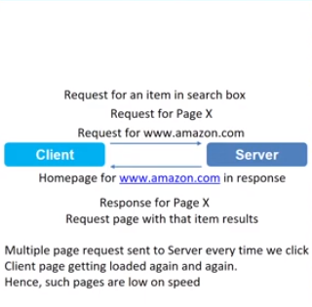
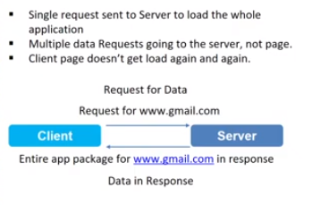
What are SPAs?
Non SPAs
Single web page applications.
Entire app package comes
as response with single request.

Slide 6
Why AngularJS?
Only JS is not ideal for SPAs.
We have variety of frameworks and libraries instead which will make it possible for JS to create SPAs.
Framework – is the basic structure, It helps in easy development, It provides basic configuration.
AngularJS is a JavaScript framework.

Slide 7
AngularJS is a JavaScript Framework
AngularJS is a JavaScript framework
It is a library written in JavaScript
AngularJS is distributed as a JavaScript file, and can be added to a web page with a script tag:
<script src="https://ajax.googleapis.com/ajax/libs/angularjs/1.6.4/angular.min.js"> </script>

Slide 8
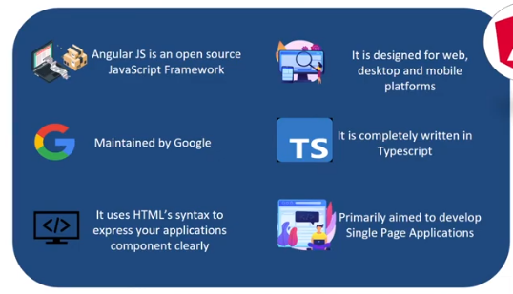
Summary (What is AngularJS? )

Slide 9
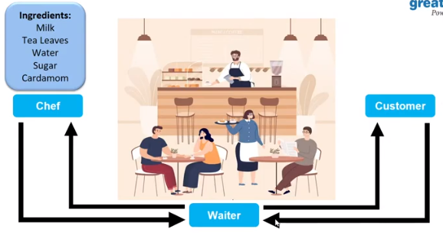
MVC Architecture (Analogy)

Slide 10
AngularJS MVC architecture
Model View Controller or MVC as it is popularly called, is a software design pattern for developing web applications.
It is very popular because it isolates the application logic from the user interface layer and supports separation of concerns.
A Model View Controller pattern is made up of the following three parts −
Model − It is the lowest level of the pattern responsible for maintaining data.
View − It is responsible for displaying all or a portion of the data to the user.
Controller − It is a software Code that controls the interactions between the Model and View.

Slide 11
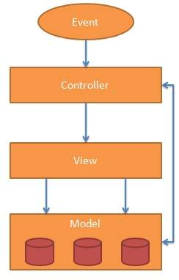
The Model:
The model is responsible for managing application data. It responds to the request from view and to the instructions from controller to update itself.
The View
A presentation of data in a particular format, triggered by the controller's decision to present the data. They are script-based template systems such as JSP, ASP, PHP and very easy to integrate with AJAX technology.
The Controller
The controller responds to user input and performs interactions on the data model objects. The controller receives input, validates it, and then performs business operations that modify the state of the data model.
AngularJS is a MVC Based Framework

Slide 12
AngularJS Extends HTML
AngularJS lets you extend HTML with new attributes called Directives
2 ways:
AngularJS has a set of built-in directives which offers functionality to your applications.
AngularJS also lets you define your own directives.

Slide 13
Built-in directives
AngularJS extends HTML with ng-directives
The ng-app directive defines an AngularJS application.
The ng-app directive defines the root element of an AngularJS application
The ng-app directive will auto-bootstrap (automatically initialize) the application when a web page is loaded

Slide 14
Built-in directives (Contd)
The ng-model is a directive binds input, select and textarea, and stores the required user value in a variable and we can use that variable whenever we require that value (Bind the value of HTML with AngularJS).
The ng-model directive can also:
  Provide type validation for application data (number, email, required)
  Provide status for application data (invalid, dirty, touched, error)
The ng-bind directive tells AngularJS to replace the text content of the specified HTML element with the value of a given expression, and to update the text content when the value of that expression changes

Slide 15
AngularJS Example
<html>
<script src="https://ajax.googleapis.com/ajax/libs/angularjs/1.6.4/angular.min.js"></script>
<body>
<div ng-app="">
<p>Name: <input type="text" ng-model="name"></p>
<p ng-bind="name"></p>
</div>
</body>
</html>
REFER P1.HTML

Slide 16
AngularJS starts automatically when the web page has loaded
The ng-app directive tells AngularJS that the <div> element is the "owner" of an AngularJS application
The ng-model directive binds the value of the input field to the application variable name
The ng-bind directive binds the innerHTML of the <p> element to the application variable name

Slide 17
ng-init directive
The ng-init directive initializes data for the AngularJS application variables.
It defines the initial value for an AngularJs application and assigns values to the variables.
Normally, we will not use ng-init; Will use a controller or module instead
<div ng-app="" ng-init="firstName='John'">
<p>The name is <span ng-bind="firstName"> </span></p>
</div>

Slide 18
data-ng-
You can use data-ng-, instead of ng-, if you want to make your page HTML valid
<div data-ng-app="" data-ng-init="firstName='John'">
<p>The name is <span data-ng-bind="firstName"> </span></p>
</div>

Slide 19
AngularJS Expressions
AngularJS expressions can be written inside double braces: {{ expression }}
AngularJS expressions can also be written inside a directive: ng-bind="expression"
AngularJS will resolve the expression, and return the result exactly where the expression is written

Slide 20
AngularJS expressions are much like JavaScript expressions: They can contain literals, operators, and variables.
Example {{ 5 + 5 }} or {{ firstName + " " + lastName }}

Slide 21
<html>
<script src="https://ajax.googleapis.com/ajax/libs/angularjs/1.6.4/angular.min.js"></script>
<body>
<div ng-app="">
<p>My first expression: {{ 5 + 5 }}</p>
</div>
</body>
</html>
REFER P2.HTML

Slide 22
Data Binding
The {{ expression }} in the example, is an AngularJS data binding expression
Data binding in AngularJS binds AngularJS expressions with AngularJS data.

Slide 23
Data Binding example
<div ng-app="" ng-init="quantity=1;price=5">
Quantity: <input type="number" ng-model="quantity">
Costs: <input type="number" ng-model="price">
Total in dollar: {{ quantity * price }}
</div>
Here:
{{ quantity * price }} is bound with ng-model=" quantity” and ng-model= “price ”

Slide 24
Without ng-app directive
If you remove the ng-app directive, HTML will display the expression as it is, without solving it
<html>
<script src="https://ajax.googleapis.com/ajax/libs/angularjs/1.6.4/angular.min.js"></script>
<body>
<p>Without the ng-app directive, HTML will display the expression as it is, without solving it.</p>
<div>
<p>My first expression: {{ 5 + 5 }}</p>
</div> </body>
</html>
REFER P3.HTML

Slide 25
Example for changing the value of CSS properties using AngularJS
Change the color of the input box, by changing its value:
<div ng-app="" ng-init="myCol='lightblue'">
<input type=“text” style="background-color:{{myCol}}" ng-model="myCol" value="{{myCol}}">
</div>
REFER P4color.HTML

Slide 26
AngularJS Numbers
AngularJS numbers are like JavaScript numbers
<div ng-app="" ng-init="quantity=1;cost=5">
<p>Total in dollar: {{ quantity * cost }}</p>
</div>
REFER P4.HTML

Slide 27
Same example using ng-bind:
<div ng-app="" ng-init="quantity=1;cost=5">
<p>Total in dollar: <span ng-bind="quantity * cost"> </span></p>
</div>
REFER P5.HTML

Slide 28
AngularJS Strings
AngularJS strings are like JavaScript strings
<div ng-app="" ng-init="firstName='John'; lastName='Doe'">
<p>The name is {{ firstName + " " + lastName }}</p>
</div>
REFER P6.HTML

Slide 29
Same example using ng-bind:
<div ng-app="" ng-init="firstName='John';lastName='Doe'">
<p>The name is <span ng-bind="firstName + ' ' + lastName"> </span></p>
</div>

Slide 30
AngularJS Objects
AngularJS objects are like JavaScript objects
<div ng-app="" ng-init = "person={firstName:'John',lastName:'Doe'}">
<p>The name is {{ person.lastName }}</p>
</div>

Slide 31
Same example using ng-bind
<div ng-app="" ng-init ="person={firstName:'John',lastName:'Doe'}">
<p>The name is <span ng-bind="person.lastName"></span></p>
</div>

Slide 32
AngularJS Arrays
AngularJS arrays are like JavaScript arrays
<div ng-app="" ng-init="points=[1,15,19,2,40]">
<p>The third result is {{ points[2] }}</p>
</div>

Slide 33
Same example using ng-bind:
<div ng-app="" ng-init="points=[1,15,19,2,40]">
<p>The third result is <span ng-bind="points[2]"></span></p>
</div>

Slide 34
AngularJS Expressions vs. JavaScript Expressions
Like JavaScript expressions, AngularJS expressions can contain literals, operators, and variables
Unlike JavaScript expressions, AngularJS expressions can be written inside HTML
AngularJS expressions do not support conditionals, loops, and exceptions, while JavaScript expressions do
AngularJS expressions support filters, while JavaScript expressions do not

Slide 35
Repeating HTML Elements
The ng-repeat directive repeats an HTML element
<div ng-app="" ng-init="names=['Jani','Hege','Kai']">
<ul>
<li ng-repeat="x in names">
{{ x }}
</li>
</ul>
</div>
The ng-repeat directive actually clones HTML elements once for each item in a collection
REFER P7.HTML

Slide 36
The ng-repeat directive used on an array of objects
<div ng-app="" ng-init="names=[
{name:'Jani',country:'Norway'},
{name:'Hege',country:'Sweden'},
{name:'Kai',country:'Denmark'}]">
<ul>
<li ng-repeat="x in names">
{{ x.name + ', ' + x.country }}
</li>
</ul>
</div>
REFER P8.HTML

Slide 37
AngularJS Modules
An AngularJS module defines an application.
A module in AngularJS is a container of the different parts of an application such as controller, service, filters, directives etc.
The module is a container for the application controllers. Controllers always belong to a module.
Modules in AngularJS is a mechanism to group components, directives, pipes and services that are related, in such a way that can be combined with other modules to create an application.

Slide 38
Creating a Module
A module is created by using the AngularJS function angular.module
<div ng-app="myApp">...</div>
<script>
var app = angular.module("myApp", []);
</script>
app here is a reference created for the module myApp.
myApp is the module to control our application, so we must initialize name of module as a value to ng-app directive.
So the current application is going to be controlled by myApp module.

Slide 39
AngularJS module ….
angular.module('myApp', []);
The "myApp" parameter refers to an HTML element in which the application will run.
The [] parameter in the module definition can be used to define dependent modules
Without the [] parameter, you are not creating a new module, but retrieving an existing one
Module is to divide the code into logical chunks.

Slide 40
Create New Directives
In addition to all the built-in AngularJS directives, you can create your own directives.
A custom directive simply replaces the element for which it is activated.
New directives are created by using the .directive function
To invoke the new directive, make an HTML element with the same tag name as the new directive
When naming a directive, you must use a camel case name, w3TestDirective, but when invoking it, you must use - separated name, w3-test-directive

Slide 41
<body ng-app="myApp">
<w3-test-directive></w3-test-directive>
<script>
var app = angular.module("myApp", []);
app.directive("w3TestDirective", function() {
return {
template : "<h1>Made by a directive!</h1>"
};
});
</script>
</body>
Template property for Directives allows you to add the HTML content to the HTML.
REFER P9.HTML

Slide 42
Invoking Directives
You can invoke a directive by using:
  Element name
  Attribute
  Class
  Comment

Slide 43
Invoking directive by using Element name
<w3-test-directive></w3-test-directive>

Slide 44
Invoking directive by using Attribute
<div w3-test-directive></div>
REFER P10.HTML

Slide 45
Invoking directive by using Class
<div class="w3-test-directive"></div>

Slide 46
Invoking directive by using Comment
<!-- directive: w3-test-directive -->

Slide 47
Restrictions
You can restrict your directives to only be invoked by some of the methods
By adding a restrict property with the value "A", the directive can only be invoked by attributes
var app = angular.module("myApp", []);
app.directive("w3TestDirective", function() {
return {
restrict : "A",
template : "<h1>Made by a directive!</h1>"
};
});

Slide 48
Restrictions….
The legal restrict values are:
  E for Element name
  A for Attribute
  C for Class
  M for Comment
By default the value is EA, meaning that both Element names and attribute names can invoke the directive

Slide 49
AngularJS Controllers
We can have module control all the functionalities of application.
Different controllers control different part of application data.
Eg: Registration process, contact part in an application.
AngularJS controllers controls the flow of data in the AngularJS applications
The ng-controller directive defines the application controller.
A controller is a JavaScript Object, created by a standard JavaScript object constructor.

Slide 50
AngularJS Controllers (Contd)
<div ng-app = “MyApp" ng-controller = “controllerName">
...
</div>
To pass data between the div element (where the controller is defined) and controller, we need a $scope object which is used to bind the HTML part and controller (available to both of them).
Each controller accepts $scope as a parameter, which refers to the application/module that the controller needs to handle.
Values set by $scope will be accessible by HTML view.

Slide 51
Example:
<div ng-app="myApp" ng-controller="myCtrl">
First Name: <input type="text" ng-model="firstName"><br>
Last Name: <input type="text" ng-model="lastName"><br>
<br>
Full Name: {{firstName + " " + lastName}}
// values are passed here using $scope object, $scope applies only within this element controlled by controller.
</div> // controller controls this div element data.
<script>
var app = angular.module('myApp', []);
app.controller('myCtrl', function($scope) {
$scope.firstName = "John";
$scope.lastName = "Doe";
});
</script>
REFER P12.HTML

Slide 52
The AngularJS application is defined by ng-app="myApp“
The application runs inside the <div>
The ng-controller="myCtrl“ (name of controller) attribute is an AngularJS directive. It defines a controller.
The myCtrl controller has a JavaScript function , which contains code that will be controlled by controller.
AngularJS will invoke the controller with a $scope object.

Slide 53
In AngularJS, $scope is the application object (the owner of application variables and functions)
The controller creates two properties (variables) in the scope (firstName and lastName)
The ng-model directives bind the input fields to the controller properties (firstName and lastName)

Slide 54
AngularJS Scope
The scope is the binding part between the HTML (view) and the JavaScript (controller)
The scope is an object with the available properties and methods
The scope is available for both the view and the controller

Slide 55
Understanding the Scope
If we consider an AngularJS application to consist of:
  View, which is the HTML
  Model, which is the data available for the current view
  Controller, which is the JavaScript function that makes/changes/removes/controls the data
Then the scope is the Model
The scope is a JavaScript object with properties and methods, which are available for both the view and the controller

Slide 56
Scope with ng-repeat
<div ng-app="myApp" ng-controller="myCtrl">
<ul>
<li ng-repeat="x in names">{{x}}</li>
// names within the scope is displayed using ng-repeat using {{x}}
</ul>
</div>
<script>
var app = angular.module('myApp', []);
app.controller('myCtrl', function($scope) {
$scope.names = ["Emil", "Tobias", "Linus"];
});
</script>

Slide 57
It is important to know which scope you are dealing with, at any time
When dealing with the ng-repeat directive, each repetition has access to the current repetition object
Each <li> element has access to the current repetition object, in this case a string, which is referred to by using x

Slide 58
Root Scope
All applications have a $rootScope which is the scope created on the HTML element that contains the ng-app directive
The rootScope is available in the entire application
If a variable has the same name in both the current scope and in the rootScope, the application uses the one in the current scope

Slide 59
<body ng-app="myApp">
<p>The rootScope's favorite color:</p>
<h1>{{color}}</h1>
<div ng-controller="myCtrl">
<p>The scope of the controller's favorite color:</p>
<h1>{{color}}</h1>
</div>
<p>The rootScope's favorite color is still:</p>
<h1>{{color}}</h1>
<script>
var app = angular.module('myApp', []);
app.run(function($rootScope) {
$rootScope.color = 'blue';
});
app.controller('myCtrl', function($scope) {
$scope.color = "red";
});
</script>
</body>
REFER P19.HTML

Slide 60
Controller Methods
A controller can also have methods (variables as functions)

Slide 61
<div ng-app="myApp" ng-controller="personCtrl">
First Name: <input type="text" ng-model="firstName"><br>
Last Name: <input type="text" ng-model="lastName"><br>
<br>
Full Name: {{fullName()}}
</div>
<script>
var app = angular.module('myApp', []);
app.controller('personCtrl', function($scope) {
$scope.firstName = "John";
$scope.lastName = "Doe";
$scope.fullName = function() {
return $scope.firstName + " " + $scope.lastName;
};
});
</script>
REFER P13.HTML

Slide 62
Controllers In External Files
In larger applications, it is common to store controllers in external files
REFER P14.HTML
REFER personController.js
REFER P15.HTML
REFER namesController.js

Slide 63
AngularJS ng-model Directive (with controllers)
With the ng-model directive you can bind the value of an input field to a variable created in AngularJS
<div ng-app="myApp" ng-controller="myCtrl">
Name: <input ng-model="name">
</div>
<script>
var app = angular.module('myApp', []);
app.controller('myCtrl', function($scope) {
$scope.name = "John Doe";
});
</script>

Slide 64
The binding goes both ways
If the user changes the value inside the input field, the AngularJS property will also change its value
<div ng-app="myApp" ng-controller="myCtrl">
Name: <input ng-model="name">
<h1>You entered: {{name}}</h1>
</div>

Slide 65
Type validation with ng-model
The ng-model directive can provide type validation for application data (number, e-mail, required)
<form ng-app="" name="myForm">
Email:
<input type="email" name="myAddress" ng-model="text">
<span ng-show="myForm.myAddress.$error.email">Not a valid e-mail address</span>
</form>
In the example above, the span will be displayed only if the expression in the ng-show attribute returns true
REFER P16.HTML

Slide 66
Displaying status with ng-model
The ng-model directive can provide status for application data (invalid, dirty, touched, error)
<form ng-app="" name="myForm" ng-init="myText = 'post@myweb.com'">
Email:
<input type="email" name="myAddress" ng-model="myText" required>
<h1>Status</h1>
{{myForm.myAddress.$valid}}
{{myForm.myAddress.$dirty}}
</form>
REFER P17.HTML

Slide 67
$valid - if true, the value meets all criteria
$dirty - if true, the value has been changed

Slide 68
ng-model with validation CSS classes
The ng-model directive provides CSS classes for HTML elements, depending on their status
<style>
input.ng-invalid {
background-color: lightblue;
}
</style>
<body>
<form ng-app="" name="myForm">
Enter your name:
<input name="myName" ng-model="myText" required>
</form>
REFER P18.HTML

Slide 69
AngularJS Validation CSS Classes
AngularJS includes following CSS classes with the ng-model directive to allow styling of form and input controls based on the state of form field:
  ng-empty ➔ the view does not contain a value or the value is deemed "empty",
  ng-not-empty ➔ the view contains a non-empty value
  ng-touched ➔ the control has been blurred
  ng-untouched ➔ the control hasn't been blurred
  ng-valid ➔ the model is valid
  ng-invalid ➔ the model is invalid
  ng-dirty ➔ the control has been interacted with
  ng-pristine ➔ the control hasn't been interacted with yet

Slide 70
AngularJS Filters
Filters can be added in AngularJS to format data
AngularJS provides filters to transform data:
  currency Format a number to a currency format
  date Format a date to a specified format
  filter Select a subset of items from an array
  json Format an object to a JSON string
  limitTo Limits an array/string, into a specified number of elements/characters
  lowercase Format a string to lower case
  number Format a number to a string
  orderBy Orders an array by an expression
  uppercase Format a string to upper case

Slide 71
Adding Filters to Expressions
Filters can be added to expressions by using the pipe character |, followed by a filter
The uppercase filter format strings to upper case:
<div ng-app="myApp" ng-controller="personCtrl">
<p>The name is {{ lastName | uppercase }}</p>
</div>
REFER P20.HTML

Slide 72
The lowercase filter format strings to lower case:
<div ng-app="myApp" ng-controller="personCtrl">
<p>The name is {{ lastName | lowercase }}</p>
</div>

Slide 73
Adding Filters to Directives
Filters are added to directives, like ng-repeat, by using the pipe character |, followed by a filter
The orderBy filter sorts an array
<div ng-app="myApp" ng-controller="namesCtrl">
<ul>
<li ng-repeat="x in names | orderBy:'country'">
{{ x.name + ', ' + x.country }}
</li>
</ul>
</div>
REFER P21.HTML

Slide 74
The currency Filter
The currency filter formats a number as currency
Syntax:
{{ number | currency : symbol : fractionsize }}
<h1>Price: {{ price | currency: “Rs” : 3 }}</h1>
Usage:
<div ng-app="myApp" ng-controller="costCtrl">
<h1>Price: {{ price | currency }}</h1>
</div>
By default, the locale currency format is used
REFER P22.HTML

Slide 75
The filter Filter
The filter filter selects a subset of an array
The filter filter can only be used on arrays, and it returns an array containing only the matching items
Syntax:
{{ arrayexpression | filter : expression : comparator }}
<div ng-app="myApp" ng-controller="namesCtrl">
<ul>
<li ng-repeat="x in names | filter : 'i'">
{{ x }}
</li>
</ul>
</div>
REFER P23.HTML

Slide 76
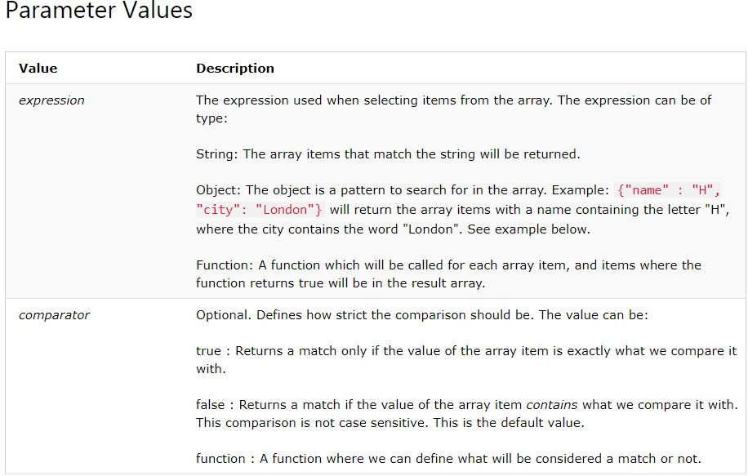

Slide 77
<div ng-app="myApp" ng-controller="arrCtrl">
<ul>
<li ng-repeat="x in customers | filter : {'name' : 'O', 'city' : 'London'}">
{{x.name + ", " + x.city}}
</li>
</ul>
</div>
<script>
var app = angular.module('myApp', []);
app.controller('arrCtrl', function($scope) {
$scope.customers = [
{"name" : "Alfreds Futterkiste", "city" : "Berlin"},
{"name" : "Around the Horn", "city" : "London"},
{"name" : "B's Beverages", "city" : "London"},
{"name" : "Bolido Comidas preparadas", "city" : "Madrid"},
{"name" : "Bon app", "city" : "Marseille"},
{"name" : "Bottom-Dollar Marketse" ,"city" : "Tsawassen"},
{"name" : "Cactus Comidas para llevar", "city" : "Buenos Aires"}
];
});
</script>

Slide 78
Filter an Array Based on User Input
By setting the ng-model directive on an input field, we can use the value of the input field as an expression in a filter
<div ng-app="myApp" ng-controller="namesCtrl">
<p><input type="text" ng-model="test"></p>
<ul>
<li ng-repeat="x in names | filter : test">
{{ x }}
</li>
</ul>
</div>
REFER P24.HTML

Slide 79
By adding the ng-click directive on the table headers, we can run a function that changes the sorting order of the array
REFER P25.HTML

Slide 80
AngularJS services
Web services, objects may also be used to provide services in web development.
Eg: Math object may provide services to add number
Services in AngularJS is simply an object to provide some sort of service that can be reused within an Angular application.
AngularJS service objects have properties and methods just like any other JavaScript object.

Slide 81
AngularJS Services
In AngularJS, a service is a function, or object, that is available for, and limited to, your AngularJS application
AngularJS has about 30 built-in services
One of them is the $location service, inject the service to the function and use the services.
The $location service has methods which return information about the location of the current web page.
$location uses window.location service.

Slide 82
The $location is used to read or change the URL in the browser and it is used to reflect that URL on our page.
Any change made in the URL is stored in the $location service in the AngularJS.
There are various methods in the $location service such as absUrl(), url([URL]), protocol(), host(), port(), path([path]), search(search, [paramValue]), hash([hash]), replace(), and state([state]).
Eg: absUrl() Method: It returns the full path of your page and it is a read-only method.
Refer to https://www.geeksforgeeks.org/angularjs-location-service/

Slide 83
var app = angular.module('myApp', []);
app.controller('customersCtrl', function($scope, $location) {
$scope.myUrl = $location.absUrl();
});
Note that the $location service is passed in to the controller as an argument.
The $location service parses the URL in the browser address bar (based on the window.location) and makes the URL available to your application.
Changes to the URL in the address bar are reflected into $location service and changes to $location are reflected into the browser address bar.

Slide 84
The $http Service
The $http service is one of the most common used services in AngularJS applications.
$http service is used to make HTTP requests to remote server using browser's XMLHttpRequest or JSONP.
The service makes a request to the server, and lets your application handle the response.
$http service is a function that has a single input parameter i.e., a configuration object.

Slide 85
Methods
The following methods are all shortcuts of calling the $http service
There are several shortcut methods:
  .delete()
  .get()
  .head()
  .jsonp()
  .patch()
  .post()
  .put()

Slide 86
Method | Description
$http.get() | Perform Http GET request.
$http.head() | Perform Http HEAD request.
$http.post() | Perform Http POST request.
$http.put() | Perform Http PUT request.
$http.delete() | Perform Http DELETE request.
$http.jsonp() | Perform Http JSONP request.
$http.patch() | Perform Http PATCH request.

Slide 87
$http.get()
$http.get() method sends http GET request to the remote server and retrieves the data.
Signature: HttpPromise $http.get(url)
$http.get() method returns HttpPromise object, which includes various methods to process the response of http GET request.

Slide 88
$http service returns a promise object, that means functions are executed asynchronously and the data may not be available immediately.
So we use then() method, and we chain with get method. To the then() method we pass an anonymous function, which will be called when the request completes successfully.
Response object is used , to retrieve the data, using the data property.
var app = angular.module('myApp', []);
app.controller('myCtrl', function($scope, $http) {
$http.get("welcome.htm").then(function (response) {
$scope.myWelcome = response.data;
});
});
REFER p1.php
Check in xamp/htdocs
REFER P27_BTN.HTML

Slide 89
Eg: issues a GET request to the specified URL, configuration object here used only 2 properties method and url.
var app = angular.module('myApp', []);
app.controller('myCtrl', function($scope, $http) {
$http({
method : "GET",
url : "welcome.htm“ // issue GET request to this url
}).then(function mySuccess(response) {
$scope.myWelcome = response.data;
}, function myError(response) {
$scope.myWelcome = response.statusText;
});
});
The example above executes the $http service with an object as an argument
The object is specifying the HTTP method, the url, what to do on success, and what to do on failure

Slide 90
Properties
The response from the server is an object with these properties:
  .config the object used to generate the request
  .data a string, or an object, carrying the response from the server
  .headers a function to use to get header information
  .status a number defining the HTTP status
  .statusText a string defining the HTTP status

Slide 91
var app = angular.module('myApp', []);
app.controller('myCtrl', function($scope, $http) {
$http.get("welcome.html")
.then(function(response) {
$scope.content = response.data;
$scope.statuscode = response.status;
$scope.statustext = response.statustext;
});
});
Check in wamp/www
REFER P30.HTML
REFER welcome.html

Slide 92
The $timeout Service
The $timeout service runs a function after a specified number of milliseconds
var app = angular.module('myApp', []);
app.controller('myCtrl', function($scope, $timeout) {
$scope.myHeader = "Hello World!";
$timeout(function () {
$scope.myHeader = "How are you today?";
}, 2000);
});
REFER P28.HTML

Slide 93
The $interval Service
The $interval service runs a function every specified millisecond
var app = angular.module('myApp', []);
app.controller('myCtrl', function($scope, $interval) {
$scope.theTime = new Date().toLocaleTimeString();
$interval(function () {
$scope.theTime = new Date().toLocaleTimeString();
}, 1000);
});
REFER P29.HTML

Slide 94
The $window service
AngularJs includes $window service which refers to the browser window object.
In the JavaScript, window is a global object which includes many built-in methods like alert(), prompt() etc.
The $window service is a wrapper around window object, so that it will be easy to override, remove or mocked for testing. It is recommended to use $window service in AngularJS instead of global window object directly.

Slide 95
<script> angular.module('windowExample', []) .controller('ExampleController', function($scope, $window)
{ $scope.greeting = 'Hello, World!';
$scope.doGreeting = function(greeting) { $window.alert(greeting); }; });
</script>
<div ng-controller="ExampleController">
<input type="text" ng-model="greeting" aria-label="greeting" /> <button ng-click="doGreeting(greeting)">ALERT</button>
</div>

Slide 96
The $log service
AngularJs includes logging service $log, which logs the messages to the browser's console.
The $log service includes different methods to log the error, information, warning or debug information. It can be useful in debugging and auditing.

Slide 97
<div ng-controller="myController">
<p>Please check the browser console for the logging information.</p>
</div>
<script>
var myApp = angular.module('myApp', []);
myApp.controller("myController", function ($log)
{
$log.log('This is log.');
$log.error('This is error.');
$log.info('This is info.');
$log.warn('This is warning.');
$log.debug('This is debugging.'); });
</script>
</body>
</html>

Slide 98
Thank You …

